Slide 1
Chapter 5
Simulation Modeling

Slide 2
Introduction
In many situations a modeler is unable to construct an analytic (symbolic) model adequately explaining the behavior being observed because of its complexity or the intractability of the proposed explicative model.
In some circumstances, it may not be feasible either to observe the behavior directly or to conduct experiments.
Examples
Elevator systems
Communications network
Location of machines in a new industrial plant
Evacuation routes
Drag forces on new designs

Slide 3
Monte Carlo Simulation
A Monte Carlo Simulation is a probabilistic technique (stochastic simulation) where a computer is used to draw samples of random numbers in order estimate the behavior of physical phenomena that may otherwise be untractable.
Examples

Slide 4
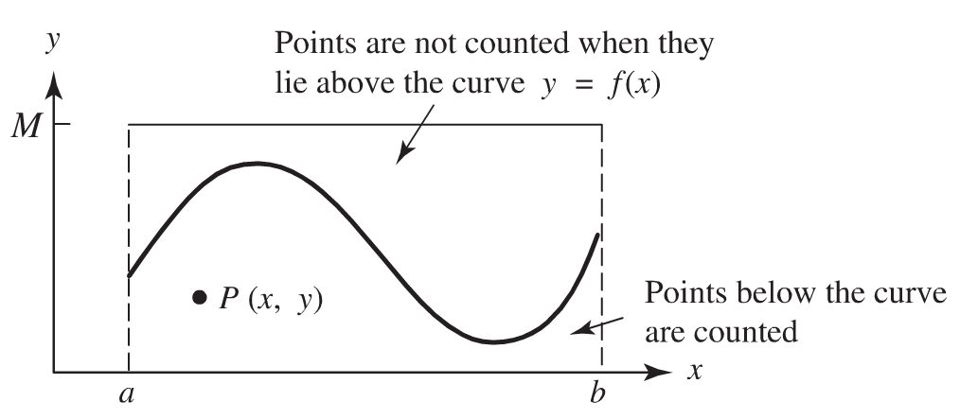
5.1 Simulating Deterministic Behavior: Area Under a Curve
Example:
Approximation of 

Slide 5
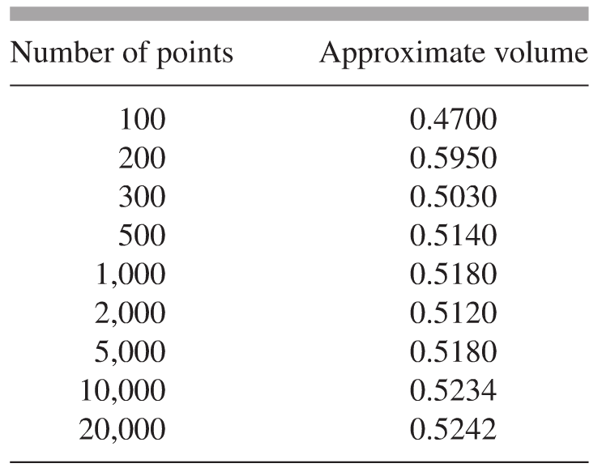
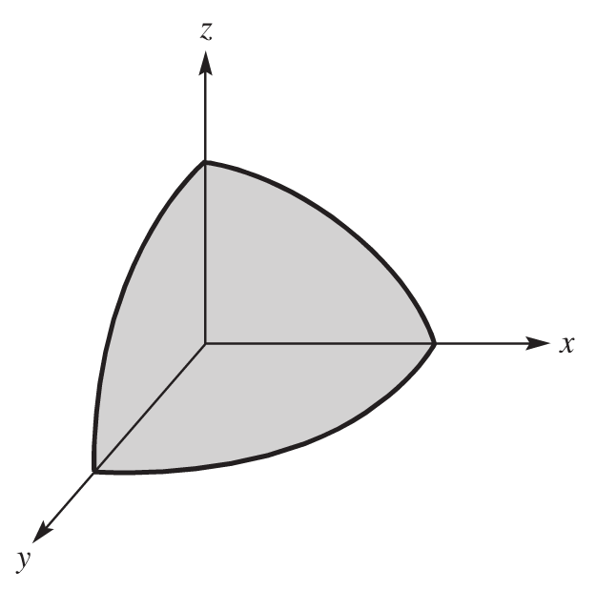
Volume Under a Surface
Volume of part of part of the sphere x² + y² + z² ≤ 1 that lies in the first octant (the actual volume is  /6 ≈ 0.5236)

Slide 6
5.2 Generating Random Numbers
Middle-Square Method
Start with a four-digit number x₀, called the seed.
Square it to obtain an eight-digit number (add a leading zero if necessary).
Take the middle four digits as the next random number.
Example
Major drawback: tendency to degenerate to zero.

Slide 7
Generating Random Numbers
Linear Congruence
Modulus c
Multiplier a
Increment b
Cycling: At some point all pseudorandom number generators begin to cycle, i.e. the sequence repeats itself.
Example
With a=1, b=7, and c=10

Slide 8
5.3 Simulating Probabilistic Behavior
Relative frequency approach to Probability:
Over the long run, the probability of an event can be thought of as the ratio
Example
Law of Large numbers for a fair coin

Slide 9
Simulating Probabilistic Behavior
Example
Monte Carlo simulation of the roll of a fair die.
Monte Carlo simulation of the roll of an unfair die.
Non-uniform random numbers.
Normally distributed random numbers

Slide 10
Simulating Probabilistic Behavior
Project #5, page 193

