Slide 1
Chapter 3
Model Fitting

Slide 2
Introduction
Possible tasks when analyzing a collection of data points:
Fitting a selected model type or types to the data
Choosing the most appropriate model from competing types that have been ﬁtted.
For example, we may need to determine whether the best-ﬁtting exponential model is a better model than the best-ﬁtting polynomial model.
Making predictions from the collected data.

Slide 3
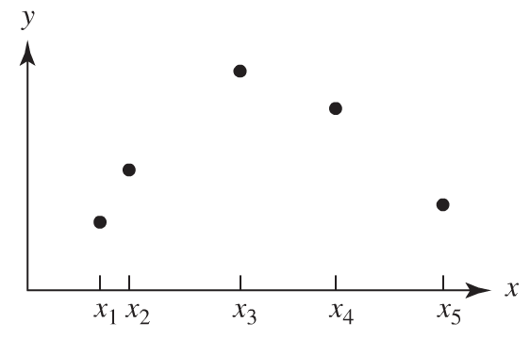
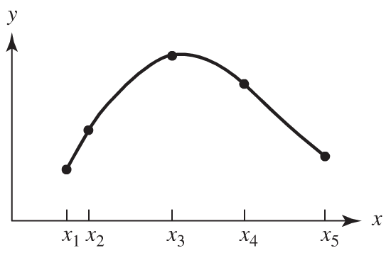
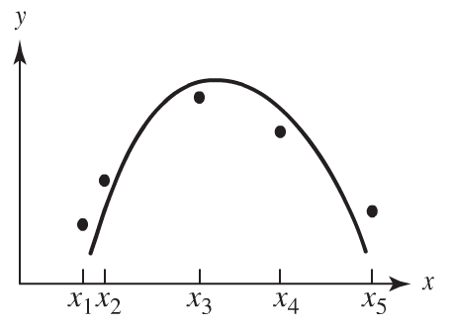
Relationship Between Model Fitting and Interpolation
The modeler tends to emphasize the proposed models over the data when model ﬁtting, whereas when interpolating, he or she places greater conﬁdence in the collected data and attaches less signiﬁcance to the form of the model. In a sense, explicative models are theory driven, whereas predictive models are data driven.

Slide 4
Sources of Error in the Modeling Process
Formulation Errors
Assumption that certain variables are negligible.
simpliﬁcations in describing interrelationships among the variables in the various submodels.
Truncation Errors
Attributable to the numerical method used to solve a mathematical problem. For example, we may ﬁnd it necessary to approximate sin x with a polynomial representation obtained from the power series
An error will be introduced when the series is truncated to produce the polynomial.

Slide 5
Sources of Error in the Modeling Process
Round-off Errors
Caused by using a ﬁnite digit machine for computation.
When many arithmetic operations are performed in succession, each with its own round-off, the accumulated effect of round-off can signiﬁcantly alter the numbers that are supposed to be the answer.
Measurement Errors
Caused by imprecision in the data collection.
This imprecision may include such diverse things as human errors in recording or reporting the data or the actual physical limitations of the laboratory equipment.

Slide 6
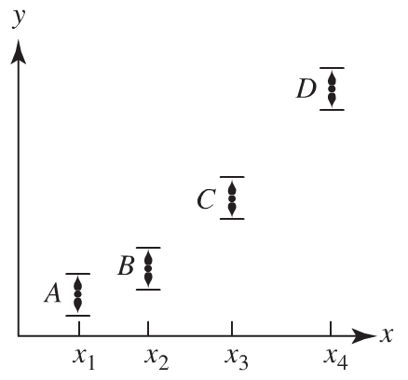
Fitting Models to Data Graphically
The modeler needs at least as many data points as there are arbitrary constants in the model curve.
The spacing of the data points within the interval of study is important because any part of the interval over which the model must ﬁt particularly well can be weighted by using unequal spacing.
It is useful to think of each data point as an interval of relative conﬁdence rather than as a single point.

Slide 7
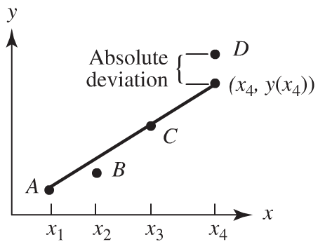
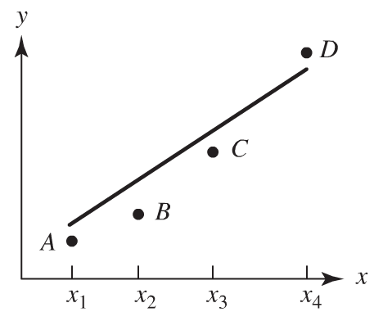
Visual Model Fitting with the Original Data
Suppose we want to ﬁt the model y = a x + b to the data shown in the figure of the previous slide
Minimizing the sum of the absolute deviations from the ﬁtted line
Minimizing the largest absolute deviation from the ﬁtted line

Slide 8
Example
What criteria would you use to fit this data set

Slide 9
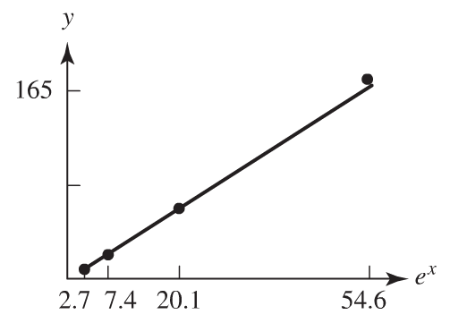
Transforming the Data
Example
Suppose, for example, that a relationship of the form y = Ce^{x} is suspected for some submodel and the data shown in table have been collected.
Plot y versus e^{x}
From the ﬁgure, the slope of the line is approximated as

Slide 10
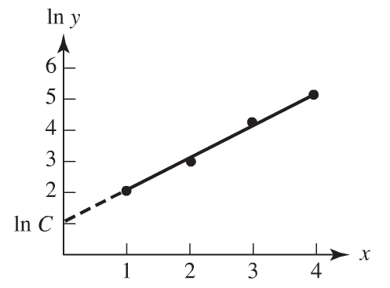
Transforming the Data
An alternative technique:
Take the logarithm of each side of the equation y = Ce^{x} to obtain
ln y = ln C + x
The intercept ln C is approximately 1.1, giving C = e^{1.1} ≈ 3.0 as before.

Slide 11
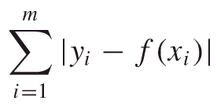
3.2 Analytic Methods of Model Fitting
Chebyshev Approximation Criterion
Given a collection of m data points (x_{i} , y_{i}), i = 1 , 2, … , m, ﬁt the collection to the line y = m x + b, determined by the parameters a and b, that minimizes the distance between any data point (x_{i} , y_{i}) and its corresponding data point on the line (x_{i} , ax_{i} + b). That is, minimize the largest absolute deviation |y_{i} − y(x_{i})| over the entire collection of data points.
Linear Programming
Simplex Method
Minimizing the Sum of the Absolute Deviations

Slide 12
Analytic Methods of Model Fitting
Least Squares Criterion.
Proof of the Minimization of the Mean Squared Residual (MSR)

Slide 13
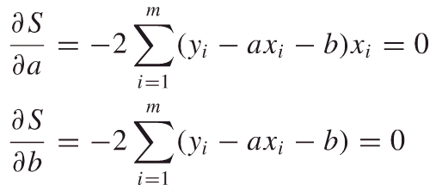
3.3 Applying the Least-Squares Criterion
Fitting a Straight Line
Suppose a model of the form y = Ax + B
Denote the least-squares estimate of y = Ax + B by y = ax + b.
Applying the least-squares criterion to this situation requires the minimization of
A necessary condition for optimality is that the two partial derivatives ∂S/∂a and ∂S/∂b equal zero, yielding the equations

Slide 14
Applying the Least-Squares Criterion for a Straight Line
Show that
The slope is given by
The y intercept is given by
These equations are called the Normal Equations.

Slide 15
Fitting a Power Curve
Use the least-squares criterion to fit a curve of the form y=Ax^{n}, where n is fixed, to a given collection of data points.
Application of the criterion requires minimization of
A necessary condition for optimality is that the derivative ds/da equal zero, giving the equation

Slide 16
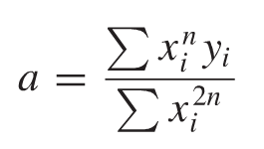
Fitting a Power Curve
Solving for a:
Example
Fit y=Ax2 to the following data
x | y
0.5 | 0.7
1 | 3.4
1.5 | 7.2
2 | 12.4
2.5 | 20.1

Slide 17
Transformed Least-Squares Fit
Suppose we wish to ﬁt the power curve y=Ax^{N} to a collection of data points. Let’s denote the estimate of A by  and the estimate of N by n. Taking the logarithm of both sides of the equation y = x^{n} yields
Since the resulting graph is a straight line, we can use the Normal Equations (for the same data set in the example)

Slide 18
Transformed Least-Squares Fit
Show that the least-squares model results in
y = 3.0852 x^{2.0628}
Suppose we still wish to fit a quadratic y = Ax² to the collection of data. Denote the estimate of A by a₁.
Taking the logarithm of both sides of the equation y = a₁x² yields
Application of the criterion requires minimization of
S=$\sum{{(ln{y −\ln{a −2\ln{x) }}}}^{2}}$

Slide 19
Transformed Least-Squares Fit
Show that the least-squares model results in
y = 3.1368 x²
The least-squares best ﬁt to the transformed equations does not coincide with the least-squares best ﬁt of the original equations.
The reason for this discrepancy is that the resulting optimization problems are different.
In the case of the original problem, we are ﬁnding the curve that minimizes the sum of the squares of the deviations using the original data, whereas in the case of the transformed problem, we are minimizing the sum of the squares of the deviations using the transformed variables.

Slide 20
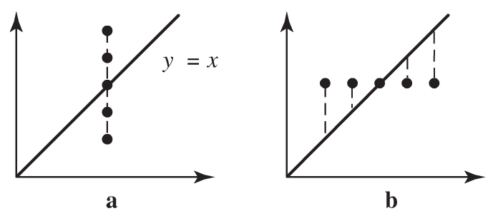
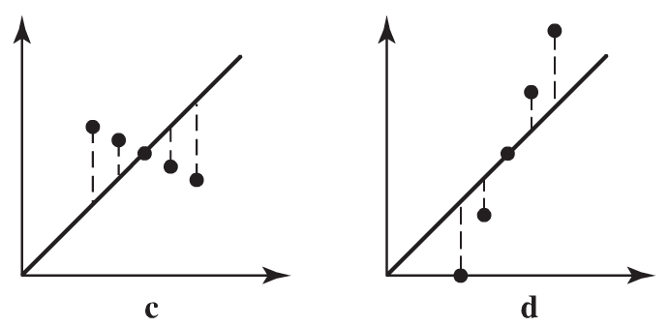
Choosing the Best Model
Which of the last three models works best?
It is tempting to choose the model that has the smallest sum of squared deviations for the given data set. However, in isolation these indicators may be very misleading.
For example, consider the data displayed in the figure. In all of the four cases, the model y = x results in exactly the same sum of squared deviations.
Without the beneﬁt of the graphs, therefore, we might conclude that in each case the model ﬁts the data about the same.
However, as the graphs show, there is a signiﬁcant variation in each model’s ability to capture the trend of the data.

Slide 21
Homework (Due Wed 09/26/12)
Page 86
Problem # 4
Page 94
Problem # 2
Page 108
Problems #4, 6 (estimate the parameters not just graphically but using all the tools learned in chapter 3)
Page 120
Problem # 2 (skip the computation of D, d_{max}, and bound for c_{max})
Problems #3, 4

