Slide 1
Chapter 2
The Modeling Process, Proportionality, and Geometric Similarity

Slide 2
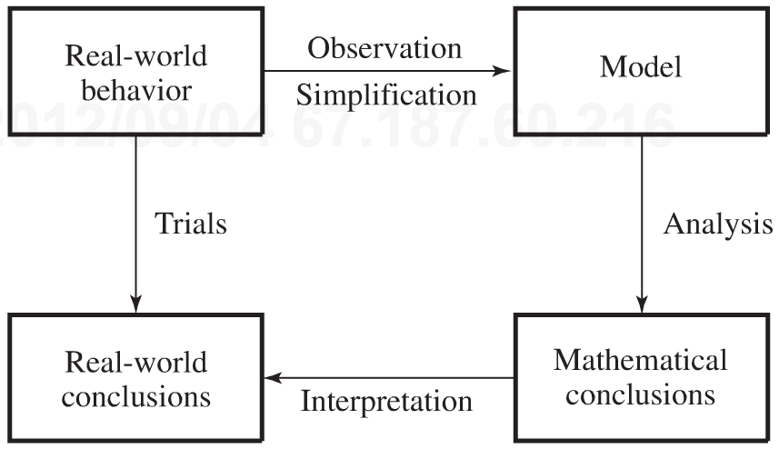
Introduction
Reaching conclusions about the behavior of real-world systems.
Modeling Procedure:
1 - Through observation, identify the primary factors involved in real-world behavior, possibly making simplifications.
2 - Conjecture tentative relationships among the factors
3 - Apply mathematical analysis to the resultant model.
4 - Interpret mathematical conclusions in terms of the real-world problem

Slide 3
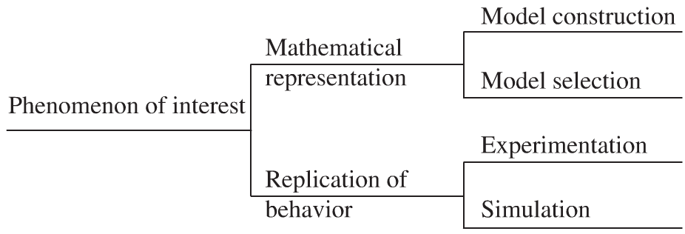
2.1 Mathematical Models
Mathematical Model:
Mathematical construct designed to study a particular real-world system or phenomenon.
The nature of the model

Slide 4
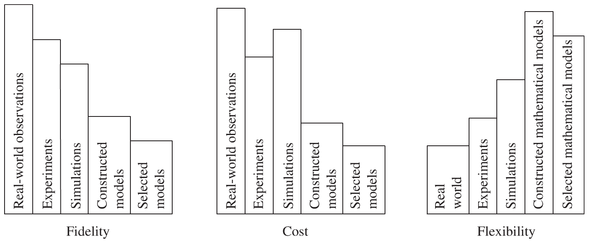
Model Comparison
Fidelity: The preciseness of a model’s representation of reality.
Costs: The total cost of the modeling process.
Flexibility: The ability to change and control conditions affecting the model as required data are gathered.

Slide 5
Construction of Models
Step 1: Identify the problem
Example: industry optimization.
Step 2: Make assumptions
Reduce the complexity of the problem.
Classify the Variables.
Dependent, independent (some may be be neglected).
Determine interrelationships among the variables selected for study.
Make additional simplifications and consider submodels to hypothesize relationships between variables.

Slide 6
Construction of Models
Step 3: Solve or interpret the model
Example: Solve the resulting mathematical equations or inequalities.
Step 4: Verify the model
Does the model answer the problem identified in step 1?
Does it make common sense?
Is the model usable in a practical sense?
Can we gather the necessary data to operate the model?
Test it with real-world data to corroborate the reasonableness of the model.
Be careful with extrapolation.

Slide 7
Construction of Models
Step 5: Implement the model
Put the Model in user-friendly mode: Explain the model in terms that the decision makers and users can understand.
Step 6: Maintain the model
Remember that the model is derived from a specific problem identified in Step 1 and from the assumptions made in Step 2.
Has the original problem changed in any way, or have some previously neglected factors become important?
Does one of the submodels need to be adjusted?

Slide 8
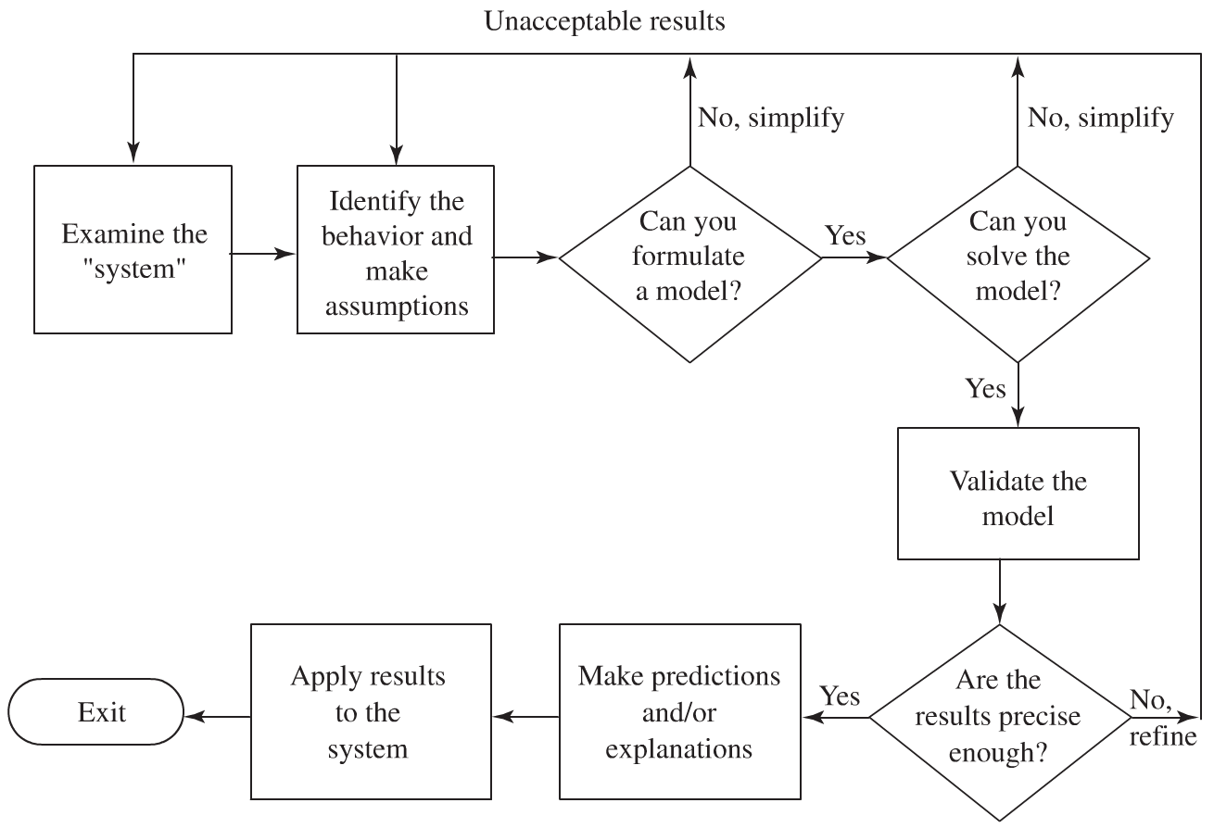
Iterative nature of Model Construction

Slide 9
Sensitivity of the Model
A model is said to be robust when its conclusions do not depend on the precise satisfaction of the assumptions.
A model is fragile if its conclusions do depend on the precise satisfaction of some sort of conditions
The term sensitivity refers to the degree of change in a model’s conclusions as some condition on which they depend is varied; the greater the change, the more sensitive is the model to that condition.

Slide 10
2.1 Modeling Using Proportionality
Recall
Other examples of proportionality relationships
Transitive rule for proportionality

Slide 11
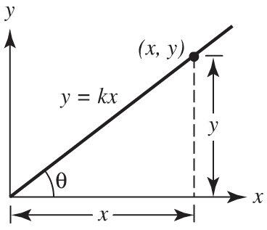
Geometric Interpretation of Proportionality
Other examples

Slide 12
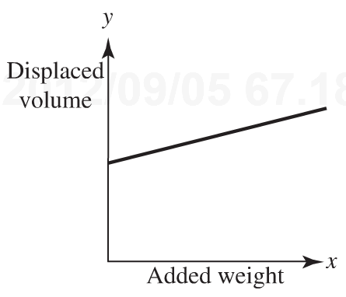
Proportionality as a Simplifying Assumption
The y-intercept must be zero so that the line passes through the origin. Failure to recognize this point can lead to erroneous results when using our model.
Example: Volume of water displaced by a boat as it is loaded with cargo

Slide 13
Famous Proportionalities
Example
Kepler’s Third Law

Slide 14
Homework (Due Wed 09/12/12)
Page 31
Problems # 1, 2, 3, 4, 6, 13
Page 49
Problems # 1, 2, 4, 7
Project Page 35
Project #2
Project
Create a model to predict the fuel efficiency of an automobile.
(Based on cars already in the market)
Page 74
Problems # 3, 5, 6, 8, 10, 12

Slide 15
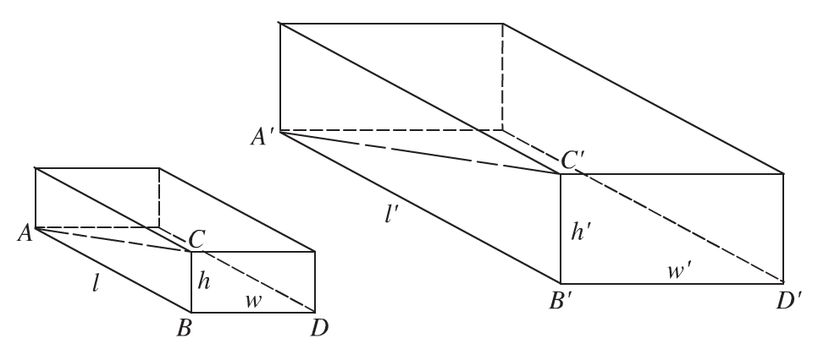
2.3 Modeling Using Geometric Similarity
Example

Slide 16
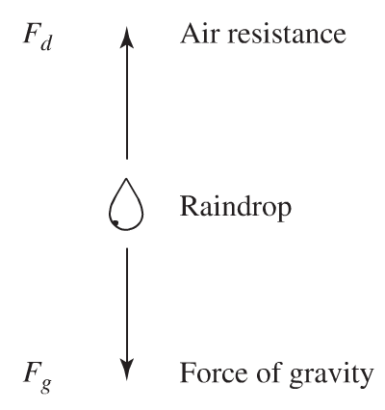
Example
Raindrops from a Motionless Cloud
Free-body diagram
F = F_{g} – F_{d} = ma
at terminal velocity
F_{g} – F_{d} = 0 or F_{g} = F_{d}
Assume that atmospheric drag on the raindrop is proportional to its surface area S times the square of its speed
F_{d}  Sv²
F_{g} = mg then F_{d}  m
Assume raindrops are geometrically similar
S  L² and V  L³
Therefore S  V^{2/3} and S  m^{2/3} (Why???)
From the equation F_{g} = F_{d} we now have m  m^{2/3}v_{t}²
Therefore m^{1/6} v_{t} (Why???)

Slide 17
Examples
Modeling a Bass Fishing Derby
Problem Identification
Assumptions
Modeling the size of the “Terror Bird”
Problem Identification
Assumptions
Modeling Fuel Efficiency…
Problem Identification (
Assumptions
NOTE: Reschedule class on 09/14/12

Slide 18
2.4 Automobile Gasoline Mileage
Scenario
Problem Identification
What is the relationship between the speed of a vehicle and its fuel mileage?
Assumptions

Slide 19
Automobile Gasoline Mileage
Restricted Problem Identification
For a particular driver, driving his or her car on a given day on a level highway at constant highway speeds near the optimal speed for fuel economy, provide a qualitative explanation of how fuel economy varies with small increases in speed.
Model Formulation and Analysis
At constant speed the forces of propulsion and resistance must be in equilibrium
F_{p} = F_{r}
Power available to the car:
C_{r}K
Where Cr represents the amount of fuel burned per unit of time
and K represents the amount of energy per gallon.

Slide 20
Automobile Gasoline Mileage
Power is the product of force and velocity for a constant force
F_{p}v  C_{r}K
For constant fuel rating
F_{p}  C_{r}/v
Resisting Force (drag force)
F_{r}  Sv² , and since S is constant F_{r}  v²
Since F_{p} = F_{r}
C_{r}/v  v² , or C_{r}  v³
Define gasoline mileage as follows
mileage = distance / consumption
Substituting vt for distance and C_{r}t for consumption
mileage = v/C_{r}  v^{–2}

Slide 21
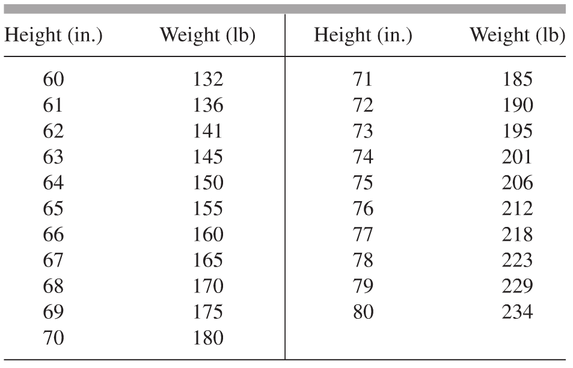
2.5 Body Weight and Height
Problem Identification
For various heights, genders, and age groups, determine upper weight limits that represent maximum levels of acceptability based on physical appearance.
Examples
Marathon rule: 2lb of body weight per inch of height
Upper weight allowance for acceptance to an armed force

Slide 22
Body Weight and Height
Assumptions
Some parts of the body are composed of an inner core (bones and muscle) an and outer core (fatty material)
Certain parts of the body, such as the head, have the same size and density for different people.
W = k₁ +W_{in} + W_{out}
W_{in}  ??
W_{out}  ??
W =

