Slide 1
Chapter 13
Optimization of Continuous Models

Slide 2
13.1 An Inventory Problem: Minimizing the Cost of Delivery and Storage
Scenario
Gasoline Station
A chain of gasoline stations has hired us as consultants to determine how often and how much gasoline should be delivered to the various stations.
Problem Identification
How often and how much gasoline should be ordered and delivered to the gas stations to maximize profit.
Since total revenue is constant, total proﬁt can be maximized by minimizing the total costs.
Two sources of cost:
Delivery Costs
Storage Costs

Slide 3
Minimizing the Cost of Delivery and Storage
Assumptions
Stored product does not perish.
Market stability of the selling price of the product and cost of raw materials.
Stability of the demand for the product by the consumer.
Storage Costs
Constant per unit storage cost.
Assumptions being made
Capital tied up
Economies of scale

Slide 4
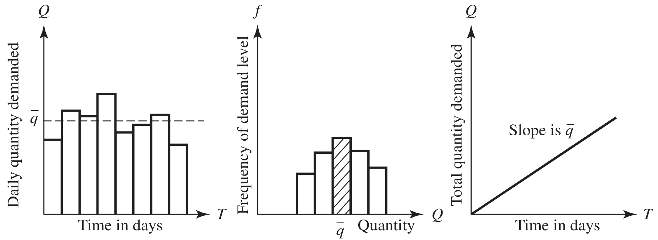
Minimizing the Cost of Delivery and Storage
Delivery Costs
Amount delivered
Plus fix rate per delivery
Demand
Assumptions
Constant daily demand
Continuous demand over time

Slide 5
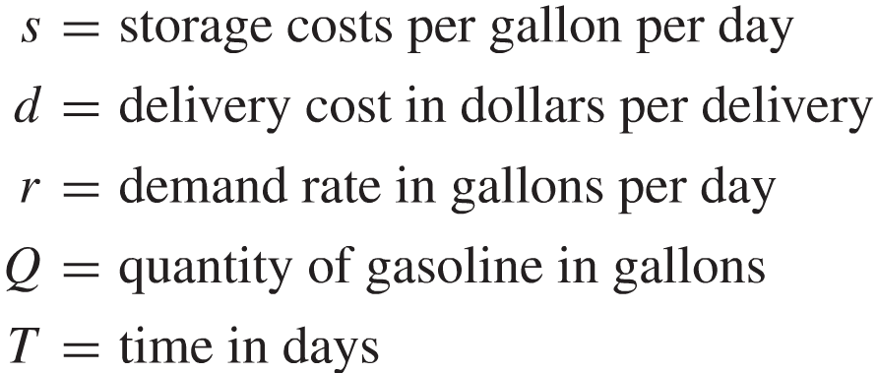
Minimizing the Cost of Delivery and Storage
Model Formulation

Slide 6
Minimizing the Cost of Delivery and Storage
Express the cost as a function of the lot size x.
Find the lot size that minimizes the cost.

Slide 7
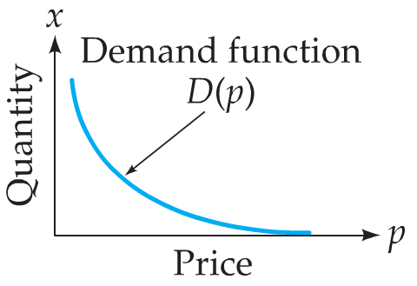
Further Optimization Applications: Elasticity of Demand
Revenue
R(x) = p ∙ q , and q = D(p)
When one of these quantities rises, the other falls. The question is whether the rise in one is enough to compensate for the fall in the other.

Slide 8
Further Optimization Applications: Elasticity of Demand
Elasticity of Demand
Relative rate of change (Logarithmic differentiation)

Slide 9
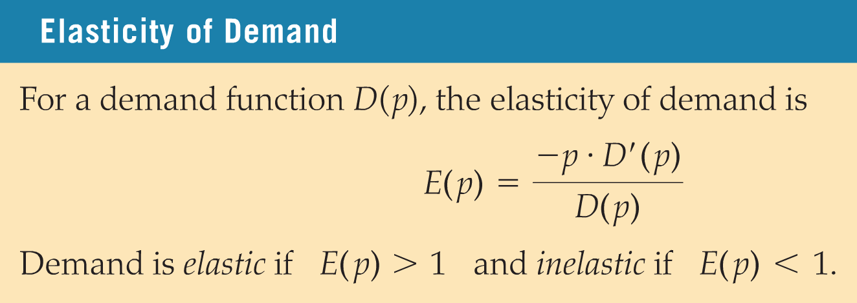
Further Optimization Applications: Elasticity of Demand
Prove that at maximum revenue, E(p) = 1

Slide 10
13.2 A Manufacturing Problem: Maximizing Profit in Producing Competing Products
Scenario
A company manufacturing computers plans to introduce two new products.
Workstation with a 27” Monitor
Cost to produce: $1950
MSRP: 3390
For each additional system sold, the selling price will fall by $0.10
The selling price is reduced by $0.03 for each 31-in. system sold
Workstation with a 31” Monitor
Cost to produce: $2250
MSRP: 3990
For each additional system sold, the selling price will fall by $0.10
The selling price is reduced by $0.04 for each 27-in. system sold
Company’s Fixed Cost: $400,000

Slide 11
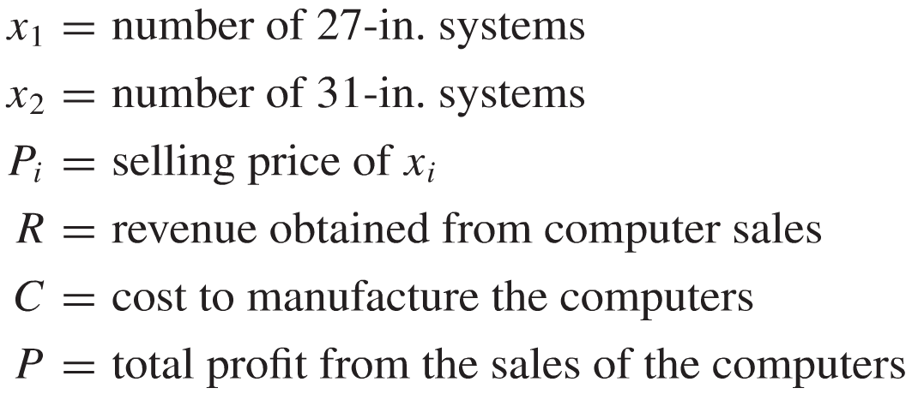
A Manufacturing Problem: Maximizing Profit in Producing Competing Products
Model Formulation
Notation
What is the objective function?

Slide 12
A Manufacturing Problem: Maximizing Profit in Producing Competing Products
Model Formulation
Maximize this objective function.
Surface Plot

Slide 13
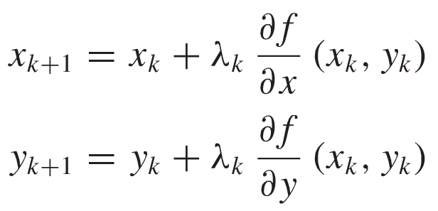
A Manufacturing Problem: Maximizing Profit in Producing Competing Products
The Gradient Method of Steepest Ascent
Iterative method for ﬁnding extreme points.
Starting with an initial point (x₀, y₀), we develop an iterative procedure for generating a sequence of points (x_{k}, y_{k}) obtained by moving from point to point in the direction of the gradient ∇f(x_{k}, y_{k}) such that f(x_{k+1}, y_{k+1}) > f(x_{k}, y_{k}). In terms of coordinates, for some λ_{k} > 0,
Implementation

Slide 14
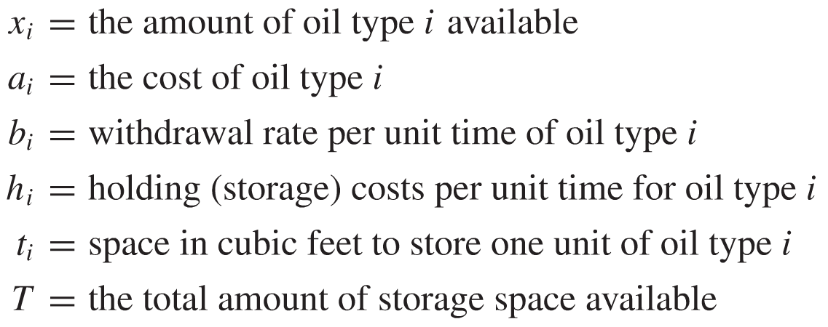
13.3 Constrained Continuous Optimization
Example
An Oil Transfer company
Problem Identification
Minimize the costs associated with dispensing and holding the oil to maintain sufﬁcient oil to satisfy demand while meeting the restricted tank storage space constraint.
Assumptions and Model Formulation
For two types of oil ( i=1, 2 ):

Slide 15
Constrained Continuous Optimization
Objective function
Minimize the cost function
Constraint
Restricted tank storage (space constraint).
Under the following data

Slide 16
Constrained Continuous Optimization
Model Solution
Lagrange Multipliers
For our problem
Minimize by differentiating and setting the partial derivatives equal zero.
Solve the algebraic system and interpret the solutions.
Shadow Price

Slide 17
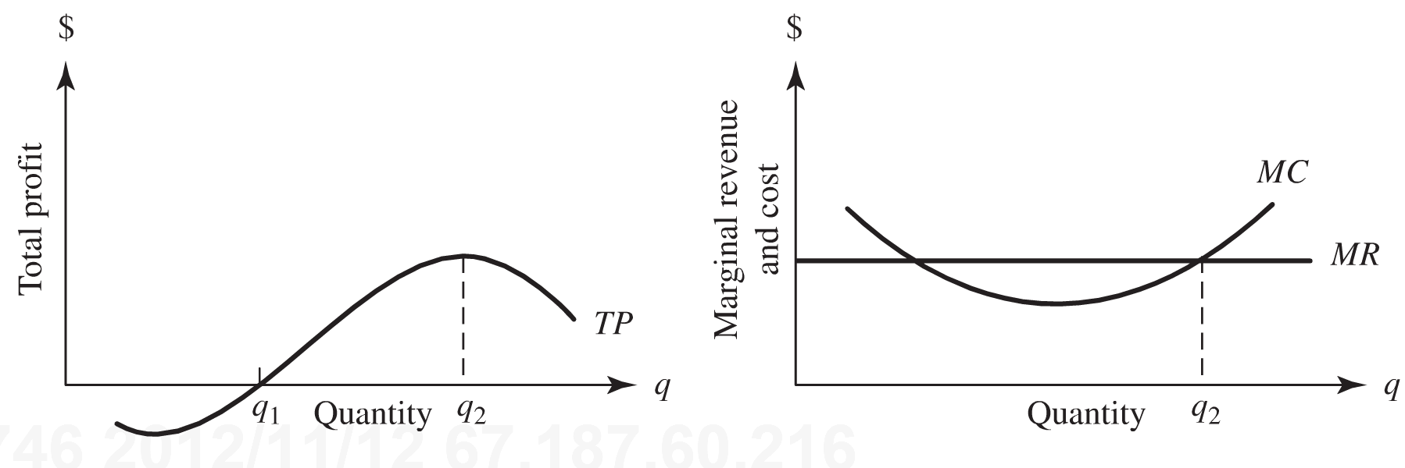
13.4 Managing Renewable Resources: The Fishing Industry
Scenario
Consider the harvesting of a common ﬁsh, such as haddock, in a large competitive ﬁshing industry.
Optimal harvesting rate that produces optimal yield while keeping the resource renewable.
Factors that affect the population level of the fish: harvesting rate of the ﬁsh and their natural reproductive rate.
Harvesting Submodel
Graphical model of the theory of the firm

Slide 18
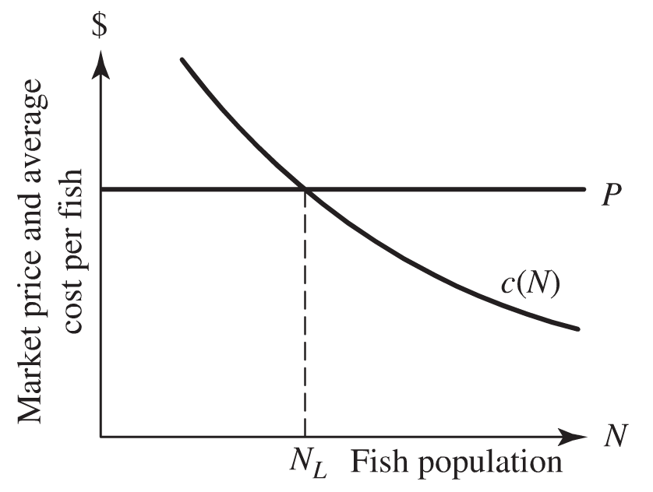
Managing Renewable Resources: The Fishing Industry
Assumptions
Competitive fishing industry: constant price.
Average unit harvesting cost c(N) decreases as the size of the ﬁsh population N increases.

Slide 19
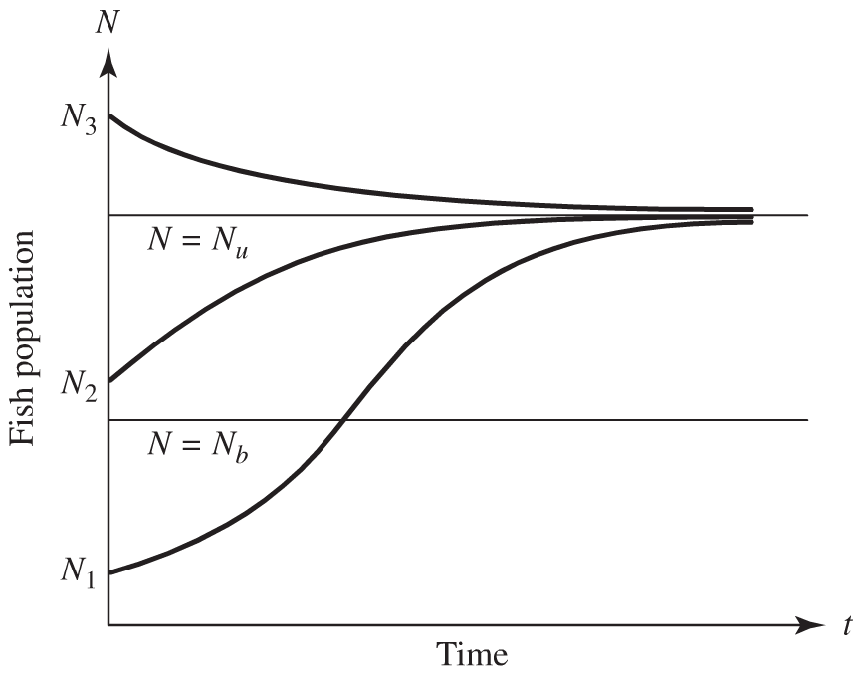
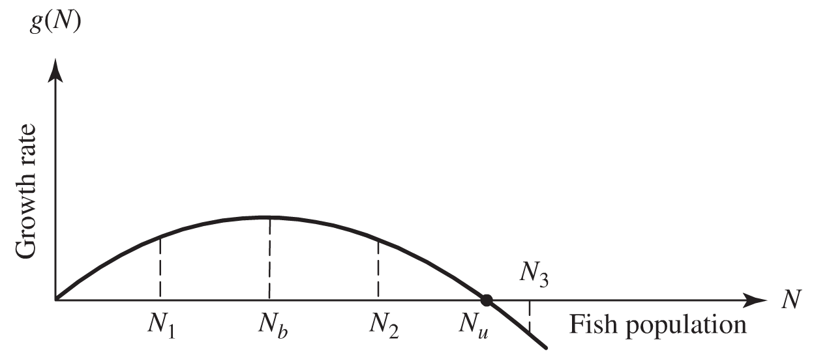
Managing Renewable Resources: The Fishing Industry
Reproduction Submodel
Let N(t) denote the size of the ﬁsh population at any time t, and let g(N) represent the rate of growth of the function N(t).

Slide 20
Managing Renewable Resources: The Fishing Industry
The Biological Optimum Population Level: N_{b}=N_{u} / 2
The Social Optimum Yield
The average proﬁt per ﬁsh is the difference between the price p and the average cost c(N) to harvest a ﬁsh. Thus, the expression for total proﬁt is
For the growth rate g(N) what is the optimum sustainable yield?

Slide 21
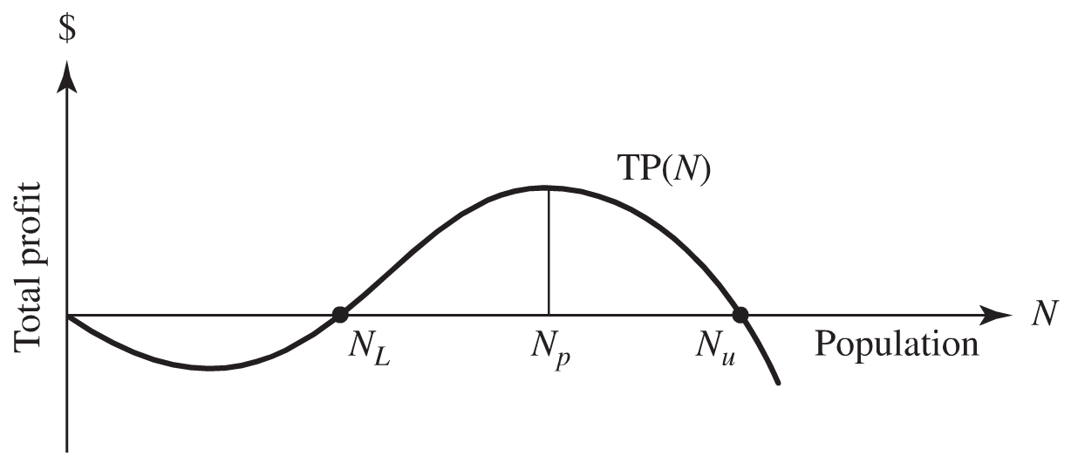
Managing Renewable Resources: The Fishing Industry
The Economic Optimum Population Level
Because g(N) reaches a maximum at N = N_{b}, we might be tempted to conclude that proﬁt is maximized there also. After all, the greatest yield occurs there. However, the average proﬁt continues to increase as N increases. Thus, by choosing N > N_{b}, we may increase the proﬁt while simultaneously catching fewer ﬁsh because g(N)< g(N_{b}).

Slide 22
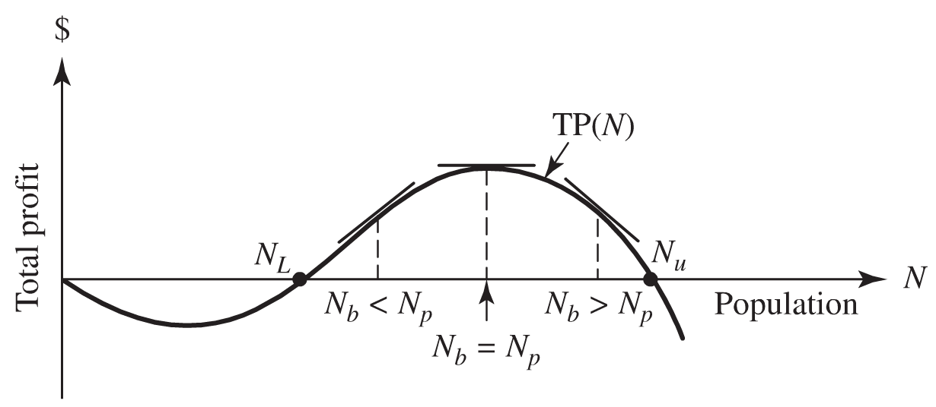
Managing Renewable Resources: The Fishing Industry
Relating All the Optimal Population Levels.
Three possible locations for N_{b}

