Slide 1
Chapter 12
Modeling with Systems of Differential Equations

Slide 2
Introduction
Systems of Differential Equations
Interaction between two quantities:
Coupled Systems
Second-Order Differential Equations as a System of two First-Order Differential Equations
Predator-Prey
Mutualism
Competitive Hunter
Even under very simple assumptions this equations are often nonlinear and generally cannot be solved analytically.
Numerical Techniques
Graphical Analysis

Slide 3
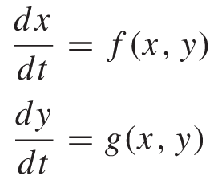
12.1 Graphical Solutions of Autonomous Systems of First-Order Differential Equations
Consider the following system of two first-order differential equations:
The system does not depend on any particular time t as the variable t does not appear explicitly on the right side of the equation. Such systems are called autonomous.
Graphing the solutions in the xy-plane, the curve whose coordinates are (x(t), y(t)), as t varies over time, is called a trajectory, path, or orbit of the system and the xy-plane is referred to as the phase plane.

Slide 4
Graphical Solutions of Autonomous Systems of Diff Eq.
If for a given point (x₀, y₀) both dx/dt and dy/dt are zero, then such a point is called a rest point, or equilibrium point, of the system.
Notice that whenever (x₀, y₀) is a rest point, the equations x = x₀ and y = y₀ give a solution to the system, that is, the trajectory associated with this solution is simply the rest point (x₀, y₀)
Stability
The rest point (x₀, y₀) is stable if any trajectory that starts close to the point stays close to it for all future time.
It is asymptotically stable if it is stable and if any trajectory that starts close to (x₀, y₀) approaches that point as t tends to inﬁnity.
If it is not stable, the rest point is said to be unstable.

Slide 5
Graphical Solutions of Autonomous Systems of Diff Eq.
Important results of the study of systems of differential equations
There is at most one trajectory through any point in the phase plane.
A trajectory that starts at a point other than a rest point cannot reach a rest point in a ﬁnite amount of time.
No trajectory can cross itself unless it is a closed curve. If it is a closed curve, it is a periodic solution.
The implications of these three properties are that from a starting point that is not a rest point, the resulting motion
will move along the same trajectory regardless of the starting time;
cannot return to the starting point unless the motion is periodic;
can never cross another trajectory; and
can only approach (never reach) a rest point.

Slide 6
Examples
Solve the linear autonomous system
Hint: Write the equation in matrix form and assume the solution is of the form x = e^{λt} v

Slide 7
Examples

Slide 8


Examples
Graph the phase plane for
Classify the equilibrium point
$$\frac{dx}{dt}=x+y$$
$$\frac{dy}{dt}=3x+y$$

Slide 9
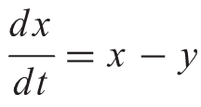
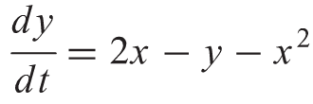
Examples
Nonlinear System
Find and classify the equilibrium points

Slide 10
Examples
Nonlinear System
Find and classify the equilibrium points

Slide 11
12.2 A Competitive Hunter Model
Example: Trout and Bass
Problem Identification
Small pond with game fish: Trout and Bass
x(t): Population of Trout
y(t): Population of Bass
Is coexistence of the two species in the pond possible?
If so, how sensitive is the final solution of population levels to the initial stockage levels and external perturbations?

Slide 12
A Competitive Hunter Model
Trout Population
In isolation
In the presence of Bass
Proceeding similarly for Bass, we obtain the following autonomous system of two first-order differential equations

Slide 13
A Competitive Hunter Model
Graphical Analysis of the Model
Will the trout and bass populations reach equilibrium levels?

Slide 14
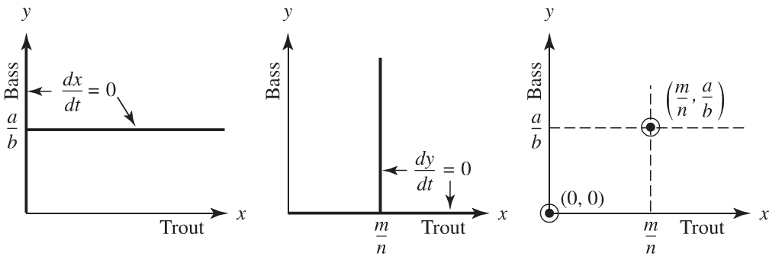
A Competitive Hunter Model
Precise values for a, b, m, n?...
what happens to the solution trajectories in the vicinity of the rest points (0, 0) and (m/ n, a/b). Specifically, are these points stable or unstable?

Slide 15
A Competitive Hunter Model

Slide 16
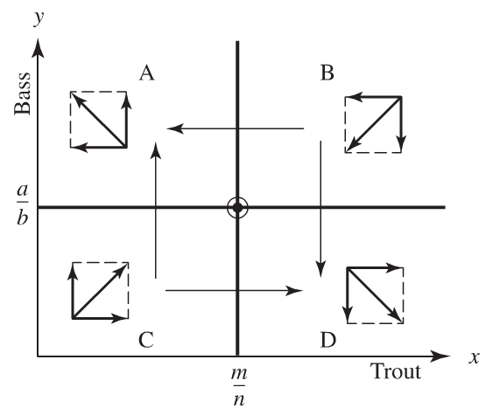
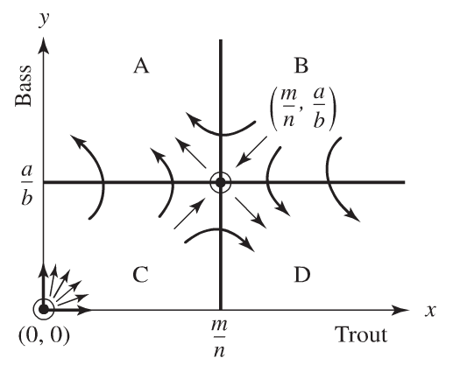
A Competitive Hunter Model
Mutual coexistence of the species is highly improbable. This phenomenon is known as the principle of competitive exclusion.

Slide 17
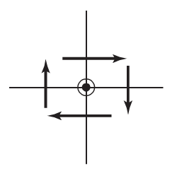
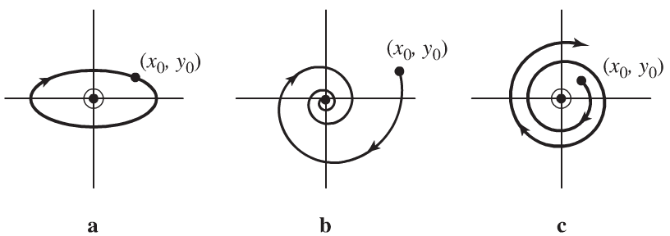
A Competitive Hunter Model
Limitations of a Graphical Analysis
Example
Trajectory direction near a rest point
This could result in any of the following three behaviors:

Slide 18
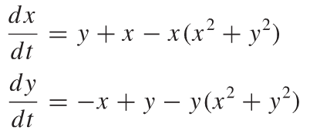
A Competitive Hunter Model
Limitations of a Graphical Analysis
Graph the trajectory behavior.
Interpret this asymptotically stable solution called a limit cycle.

Slide 19
12.3 A Predator-Prey Model
Example: Whales and Krill
Problem Identification
Whale/Krill Cycle
x(t): Population of Krill
y(t): Population of Whales
In the pristine environment, does this cycle continue indeﬁnitely or does one of the species eventually die out?
What effect does exploitation of the whales have on the balance between the whale and krill populations?
What are the implications that a krill ﬁshery may hold for the depleted stocks of baleen whales and for other species, such as seabirds, penguins, and ﬁsh, that depend on krill for their main source of food?

Slide 20
A Predator-Prey Model
Krill Population
In isolation
In the presence of whales
Whale Population
In the absence of krill the whales have no food, so we will assume that their population declines at a rate proportional to their
In the presence of krill

Slide 21
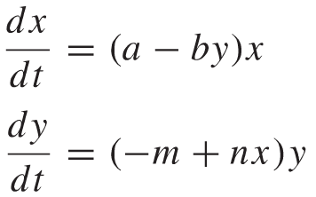
A Predator-Prey Model
Autonomous system of differential equations for our predator–prey model:
Graphical Analysis of the Model
Will the krill and whale populations reach equilibrium levels?

Slide 22
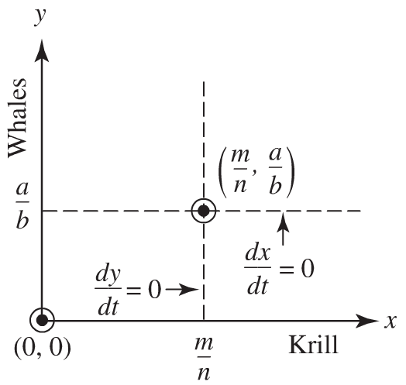
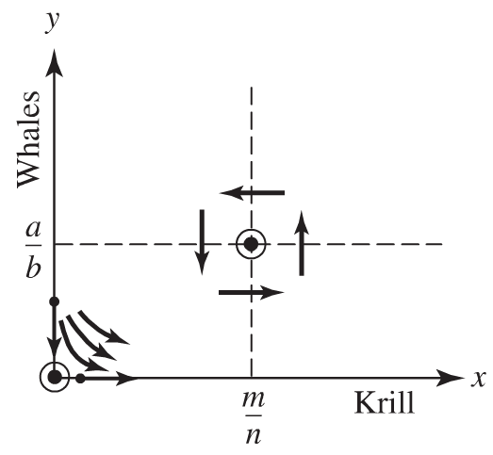
A Predator-Prey Model

Slide 23
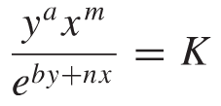
A Predator-Prey Model
An Analytic Solution of the Model
Because the number of baleen whales depends on the number of Antarctic krill available for food, we assume that y is a function of x.
Use the chain rule to rewrite this system of differential equations as a separable first-order differential equation.
Show that the solution trajectories in the phase plane are given by:

Slide 24
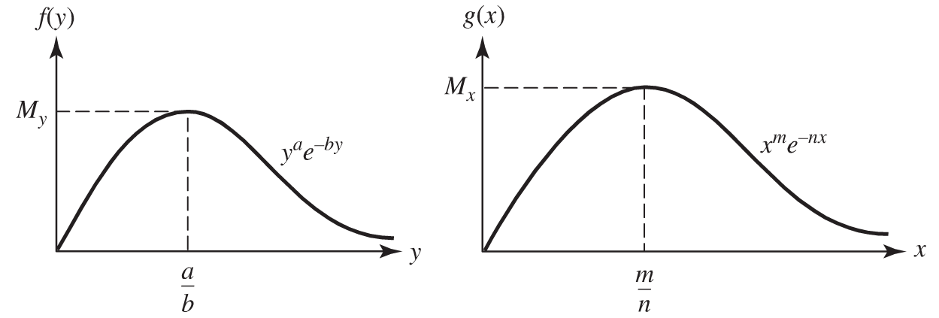
A Predator-Prey Model
Periodic Predator-Prey Trajectories
f(y)= g(x)=
Show that f(y) has a relative maximum at y = a/b and no other critical points (and similarly for g(x) at x=m/n )

Slide 25
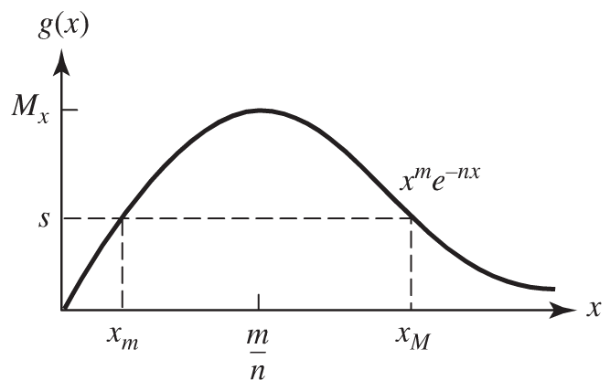
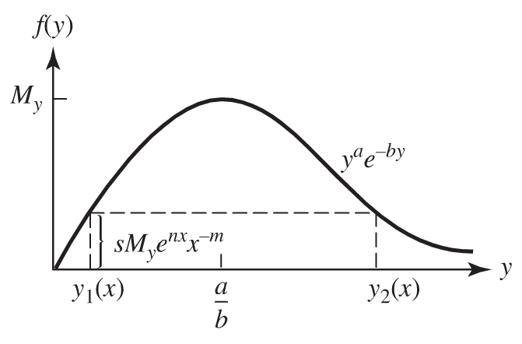
A Predator-Prey Model
Periodic Predator-Prey Trajectories (continued)
The equation has no solutions if K > MyMx and exactly one solution, x=m/n and y = a/b, when K = MyMx .
What happens when K < MyMx?
Suppose K = sMy, where s < Mx is a positive constant. Then the equation
has exactly two solutions: xm < m/n and xM > m/n

Slide 26
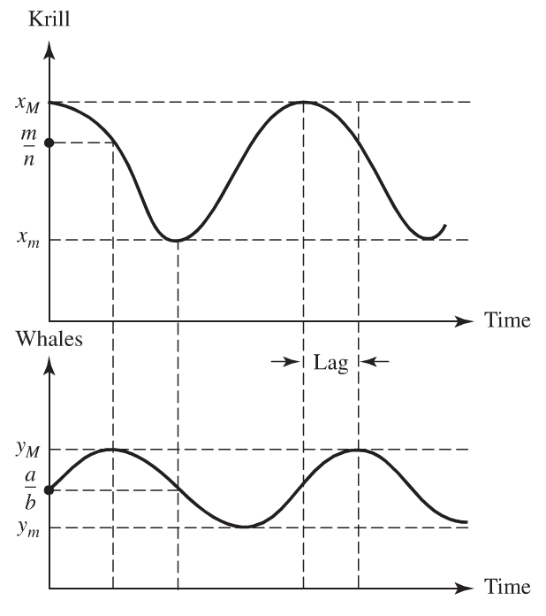
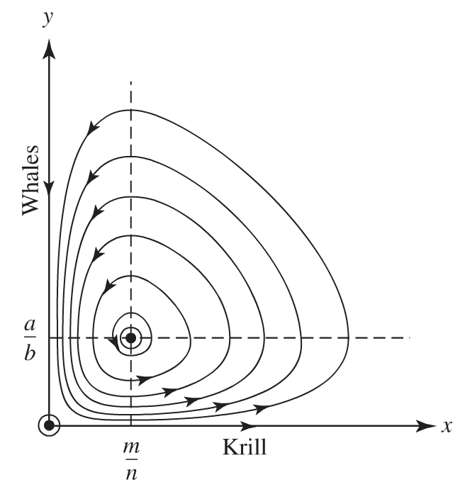
A Predator-Prey Model
Model Interpretation

Slide 27
A Predator-Prey Model
Effects of Harvesting
Let T denote the time it takes each population to complete one full cycle. Then the average populations are given by
Use
And periodicity to show that

Slide 28
A Predator-Prey Model
Effects of Harvesting (continued)
Assume that the effect of ﬁshing for krill is to decrease its population level at a rate r x(t).
Because less food is now available for the baleen whales, assume the whale population also decreases at a rate r y(t).
Incorporating these ﬁshing assumptions into our model, we obtain the reﬁned model

Slide 29
A Predator-Prey Model
Effects of Harvesting (continued)
The new average population levels will be
A moderate amount of harvesting krill (so that r < a) actually increases the average level of krill and decreases the average baleen whale population (under our assumptions for the model).
The fact that some ﬁshing increases the number of krill is known as Volterra’s principle.

Slide 30
Homework (Due Wed 11/07/12)
Page 433
Problems # 3, 4, 7, 9
Page 440
Problems # 1, 2, 3, 4
Page 472
Problem # 9
Page 478
Problem # 6
Page 489
Problem # 5

Slide 31
12.4 Two Military Examples
Lanchester Combat Models
Two homogeneous forces X (e.g., tanks) and Y (e.g., antitank weapons)
Will one force eventually win out over the other, or will the combat end in a draw?
How do the force levels decrease over time in battle?
How many survivors will the winner have?
How long will the battle last?
How do changes in the initial force levels and weapon-system parameters affect the battle’s outcome?

Slide 32
Two Military Examples: Lanchester Combat Models
Assumptions
x(t), y(t): strength of forces X and Y at time t
t is usually measured in hours or days from the beginning of the combat
Strength is simply the number of units in operation.
What assumptions have been made here
x(t) and y(t) are continuous and differentiable functions of time.

Slide 33
Two Military Examples: Lanchester Combat Models
The Model
Antitank weapon kill rate or attrition rate coefficient

Slide 34
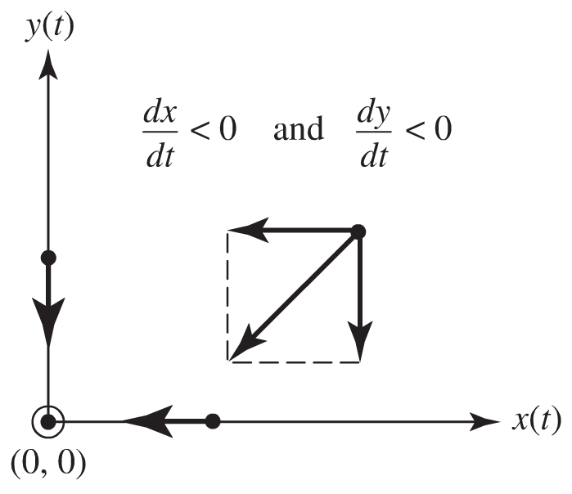
Two Military Examples: Lanchester Combat Models
Analysis of the Model
Show that the solution of the basic model is given by the Lanchester square law model
or

Slide 35
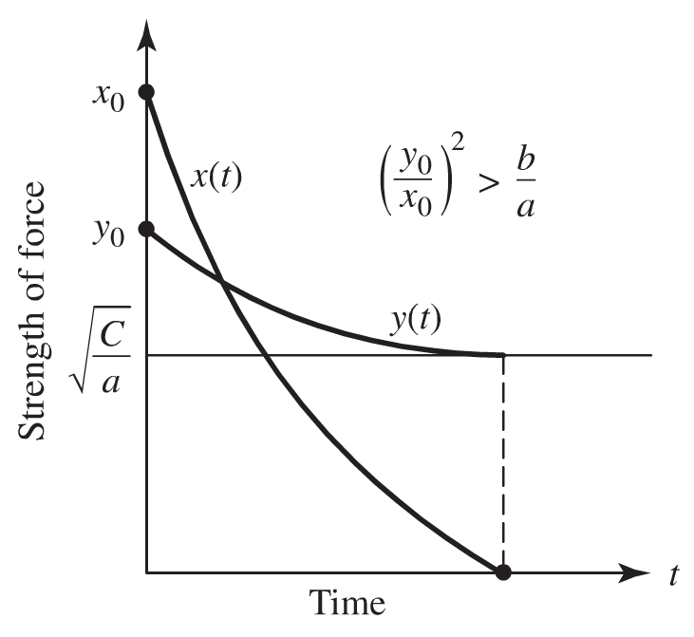
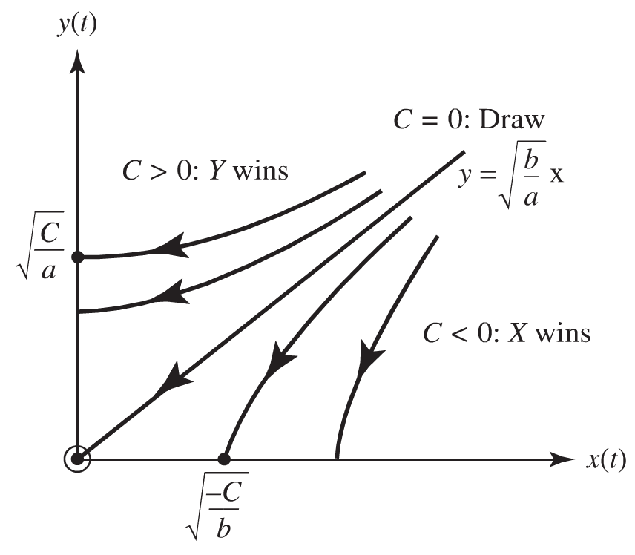
Two Military Examples: Lanchester Combat Models
Trajectories of the basic model Force level curves

Slide 36
Two Military Examples
Economic Aspects of an Arms Race
Problem Identification
Consider two countries engaged in an arms race.
Let’s attempt to assess qualitatively the effect of an arms race on the level of defense spending.
Speciﬁcally, we are interested in knowing whether the arms race will lead to uncontrolled spending and eventually be dominated by the country with the greatest economic assets.
Or will an equilibrium level of spending eventually be reached in which each country spends a steady-state amount on defense?

Slide 37
Two Military Examples: Economic Aspects of an Arms Race
Model and Assumptions

Slide 38
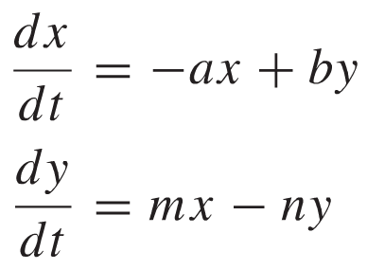
Two Military Examples: Economic Aspects of an Arms Race
Graphical Analysis of the Model
Will the defense expenditures reach equilibrium levels?
If: no grievance against the other country or perceived need of deterrance.
Rest point (x, y) = (0, 0)

Slide 39
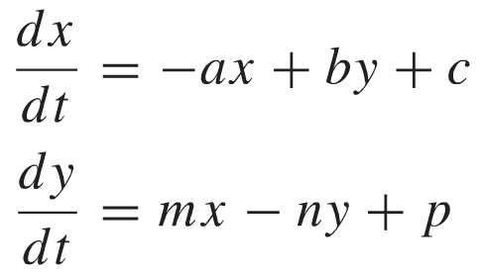
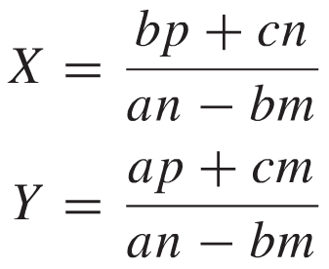
Two Military Examples: Economic Aspects of an Arms Race
If grievances that are not resolved to the mutual satisfaction of both sides do arise, the two countries will feel compelled to arm
Find the equilibrium points

Slide 40
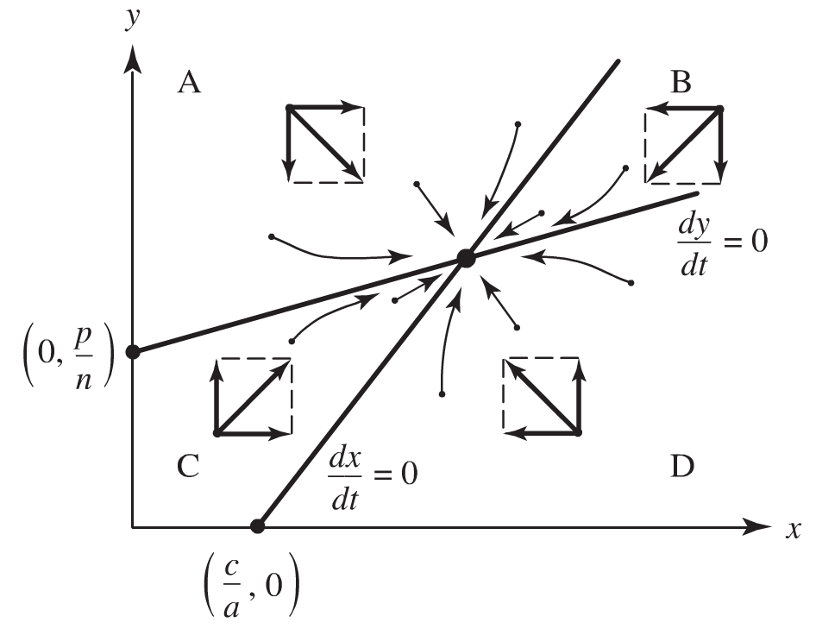
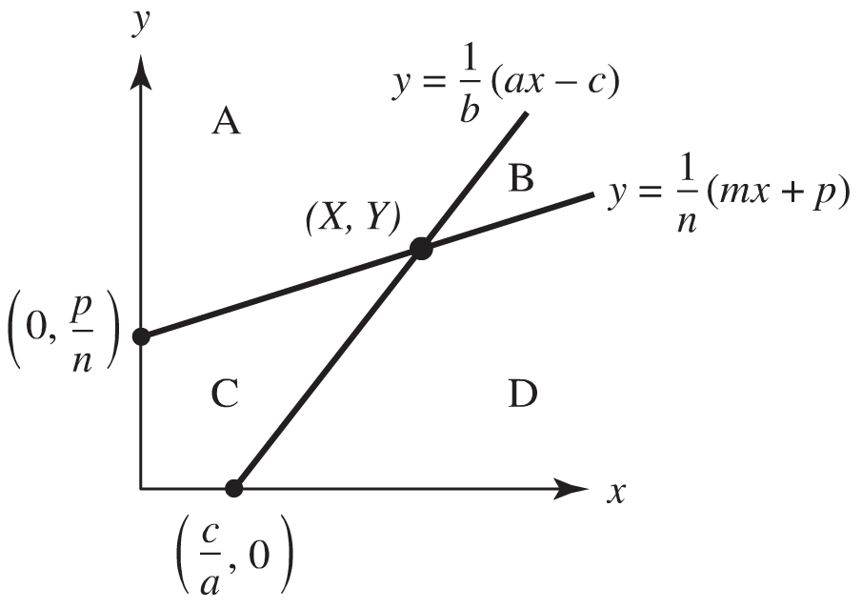
Two Military Examples: Economic Aspects of an Arms Race
Model and Trajectories
Assume (controlled spending)

Slide 41
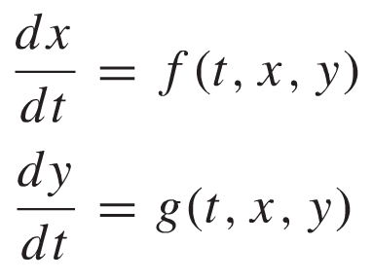
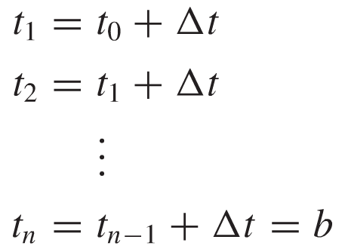
12.5 Euler’s Method for Systems of Differential Equations
For the system of two ordinary ﬁrst-order differential equations in the dependent variables x and y with independent variable t given by
We can approximate the solution using Euler’s numerical method by subdividing an interval I for the independent variable t into n equally spaced points:

Slide 42
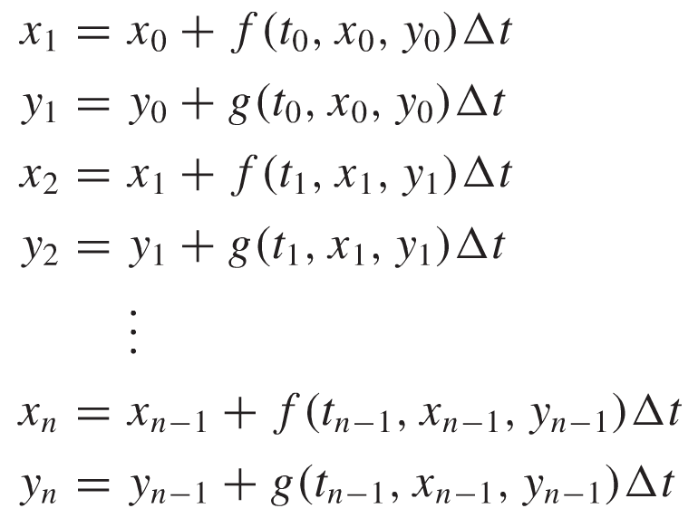
Euler’s Method for Systems of Differential Equations
We then calculate successive approximations to the solution functions

Slide 43
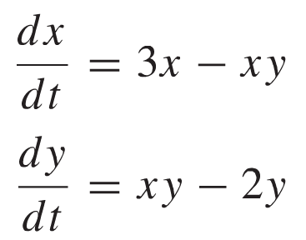
Euler’s Method for Systems of Differential Equations
Example
Use Euler’s method to ﬁnd the trajectory through the point (1, 2) in the phase plane for the following predator–prey model
Plot the trajectories for different approximations with different values for ∆t.

Slide 44
Euler’s Method for Systems of Differential Equations
Example
Numerical Solution

