Slide 1
Chapter 11
Modeling with a Differential Equation

Slide 2
Introduction
Population growth
The change in population over a time period is given by
Assuming the change is proportional to the population and expressing the constant of proportionality as a percentage per unit of time, we obtain the following difference equation:
If in our model we allow time to vary continuously we can take advantage of calculus and turn this difference equation into a differential equation:

Slide 3
11.1 Population Growth
Problem Identification
Assumptions
Assuming that during a small unit time period , a percentage b of the population is newly born and a percentage c of the population dies
Using the instantaneous rate of change of change to approximate the average rate of change, we have the following differential equation model

Slide 4
Population Growth
Solve the Model

Slide 5
Population Growth
Verify the Model
Because ln(P/P₀) = k(t− t₀), our model predicts that if we plot ln P/ P₀ versus t− t₀, a straight line passing through the origin with slope k should result.
Using census data for the population of the United states for 1970 and 1990 we can calculate the value of the constant k
That is, during the 20-year period from 1970 to 1990, population in the United States was increasing at the average rate of 1.0% per year.

Slide 6
Population Growth
Verify the Model (continued)
Using this growth rate and the population for 1990 to predict the population for 2000 yields
The 2000 census for the population of the United States was 281,400,000 (rounded to the nearest hundred thousand).
Model Refinement: Limited Growth
As the population increases and gets closer to the maximum population M (carrying capacity), the rate k decreases.
Logistic Growth:

Slide 7
Population Growth
Solve the Model

Slide 8
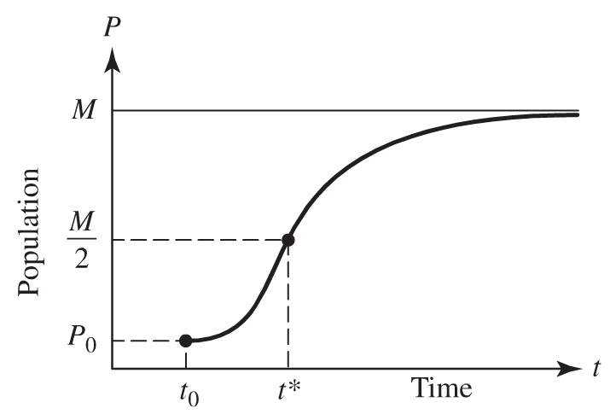
Population Growth
When do we obtain maximum growth rate?
How can we use this information to estimate M?

Slide 9
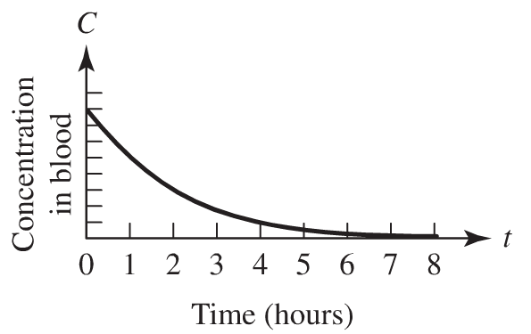
11.2 Prescribing Drug Dosage
Problem Identification
How can the doses and the time between doses be adjusted to maintain a safe but effective concentration of the drug in the blood?
The concentration in the blood resulting from a single dose of a drug normally decreases with time as the drug is eliminated from the body

Slide 10
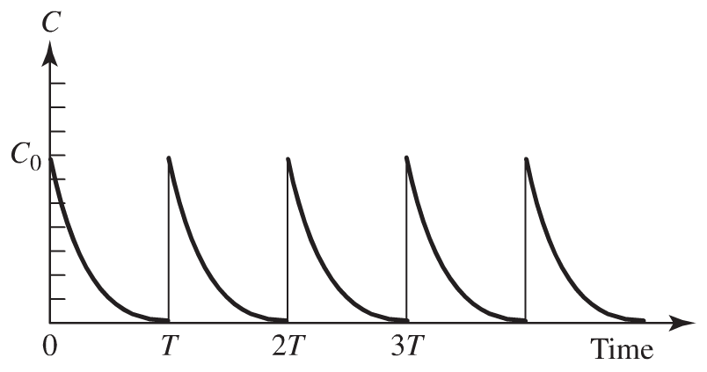
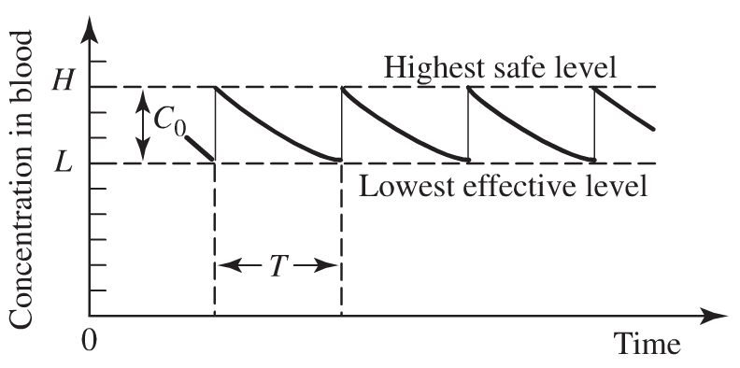
Prescribing Drug Dosage
We are interested in what happens to the concentration of the drug in the blood as doses are given at regular intervals.
If H denotes the highest safe level of the drug and L its lowest effective level, it would be desirable to prescribe a dosage C₀ with time T between doses so that the concentration of the drug in the bloodstream remains between L and H over each dose period.
Set the drug concentration for a single dose at the level C₀ = H – L

Slide 11
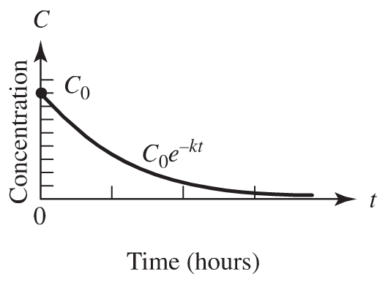
Submodels
Assumptions
Submodel for Decay Rate

Slide 12
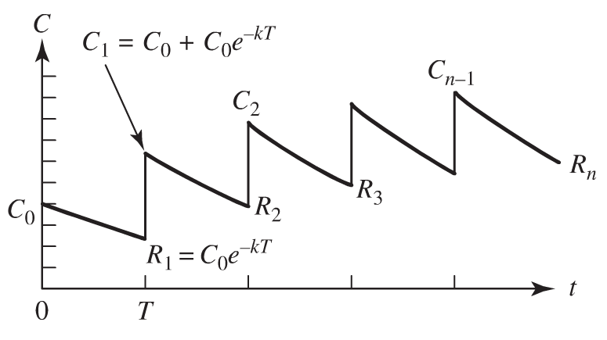
Submodels
Submodel for the Assimilation Rate
We assume an instantaneous rise in concentration whenever a drug is administered.
Drug Accumulation with Repeated Doses

Slide 13
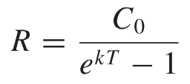
Submodels
Show that
If a dose that is capable of raising the concentration by C₀ mg/ml is repeated at intervals of T hours, then the limiting value R of the residual concentrations is given by
or
Where k is the elimination constant for the drug.

Slide 14
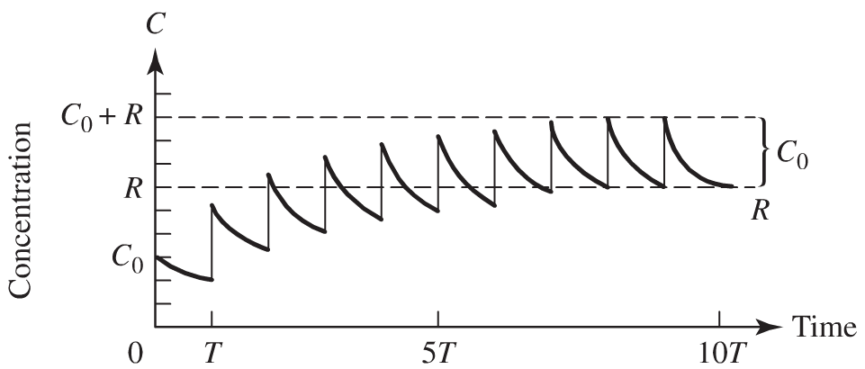
Submodels
Determining the Dose Schedule
The concentration C_{n−1} at the beginning of the nth interval is given by
If the desired dosage level is required to approach the highest safe level H, then we want C_{n−1} to approach H as n becomes large.
Since C₀ = H – L then this result yields R = L.

Slide 15
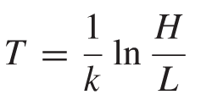
Submodels
Determining the Dose Schedule (continued)
Use the last result together with
to show that the desired dose schedule is given by

Slide 16
11.3 Braking Distance
Consider the following braking distance model
Suppose that there is a panic stop and the maximum brake force F is applied throughout the stop. The brakes are basically an energy-dissipating device; that is, the brakes do work on the vehicle producing a change in the velocity that results in a loss of kinetic energy.
Now, the work done is the force F times the braking distance d_{b}. This work must equal the change in kinetic energy, which, in this situation, is simply 0.5mv². Thus, we have

Slide 17
Braking Distance
Next, we consider how the force F relates to the mass of the car. A reasonable design criterion would be to build cars in such a way that the maximum deceleration is constant when the maximum brake force is applied, regardless of the mass of the car.
To accomplish this, Let’s assume that the braking system is designed in such a way that the maximum braking force increases in proportion to the mass of the car. Basically, this means that if the force per unit area applied by the braking hydraulic system remains constant, the surface area in contact with the brakes would have to increase in proportion to the mass of the car.
From Newton’s second law, F = ma, it follows that the force F is proportional to the mass. Combining this result with the previous equation gives the proportionality relation

Slide 18
Braking Distance
We will now use a kinematic argument based on differential equations to reach the same conclusion:
Since we are assuming that under a panic stop the maximum braking force F is applied continuously, then we obtain
for some positive proportionality constant k. Because F is the only force acting on the car under our assumptions, this gives
Integrate to show that
Where v₀ denotes the velocity at t = 0 when the brakes are initially applied

Slide 19
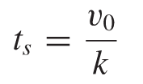
Braking Distance
From previous equation, if t_{s} denotes the time it takes for the car to stop after the brakes have been applied, then
Integrating v again to obtain the equation of movement:
Show that
Therefore, d_{b} is proportional to the square of the velocity, in accordance with the model based on energy dissipation considerations.

Slide 20
Homework (Due Wed 10/12/12)
Page 411
Problems # 1, 3
Page 421
Problems # 2, 5, 8
Work on the First Project due on 10/17/12

Slide 21
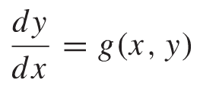
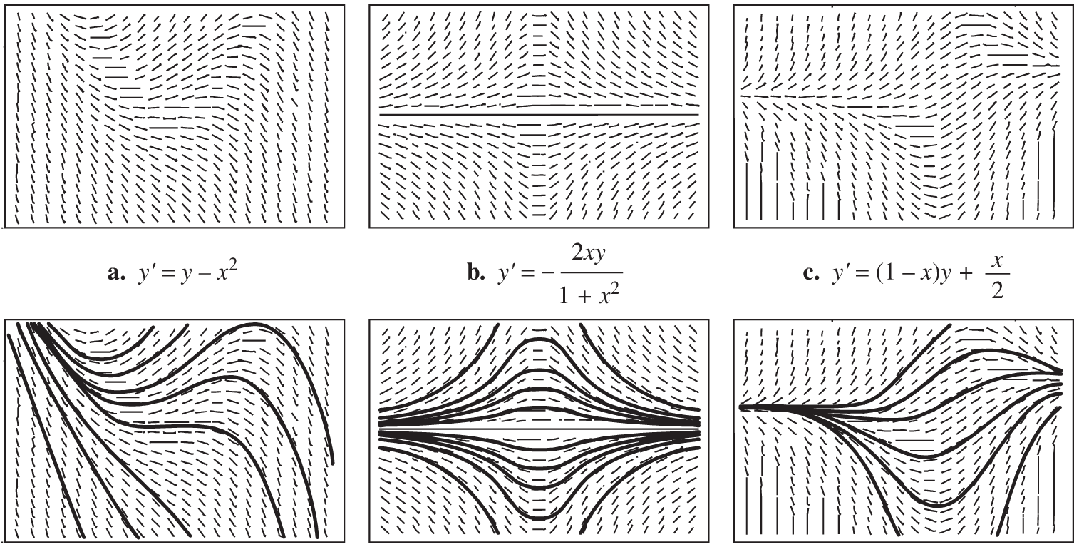
11.4 Graphical Solution of Autonomous Differential Equations
Consider the first-order differential equations of the form
The solution to these differential equations can be visualized by using Slope Fields, where a particular solution will be found depending on the initial condition.

Slide 22
Graphical Solution of Autonomous Differential Equations
A differential equation for which dy/dx is a function of y only is called an autonomous differential equation.
Example
Analyze the solutions to differential equations graphically.
Page 433 #2
Stable and Unstable Equilibria

Slide 23
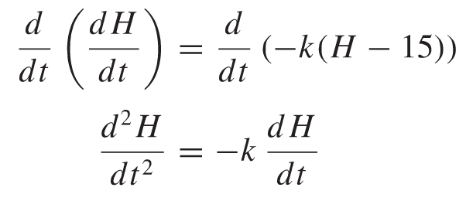
Newton’s Law of Cooling
Example
Phase line diagram
Concavity

Slide 24
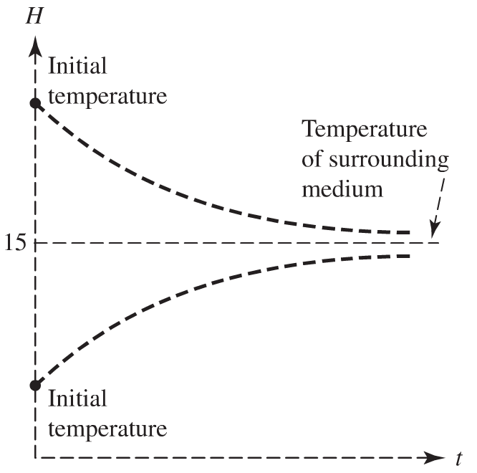
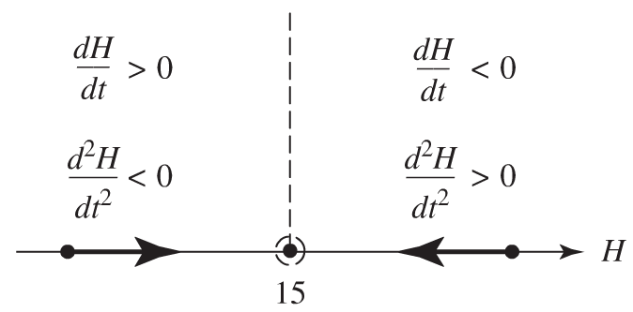
Newton’s Law of Cooling
Phase line and solution curves

Slide 25
Logistic Growth
Create the phase line for the logistic growth model
Graph solution curves

Slide 26
11.5 Numerical Approximation Methods
First-Order Initial Value Problems
Approximating the Solution by a Numerical Method
Euler’s Method

Slide 27
Numerical Approximation Methods
A Savings Certificate Revisited
Consider the value of a certiﬁcate initially worth $1000 that accumulates annual interest at 12% compounded continuously. We would like to know the value of the certiﬁcate in 10 years.
Use Euler’s method to approximate the value in 10 years if
Note that the exact solution is

Slide 28
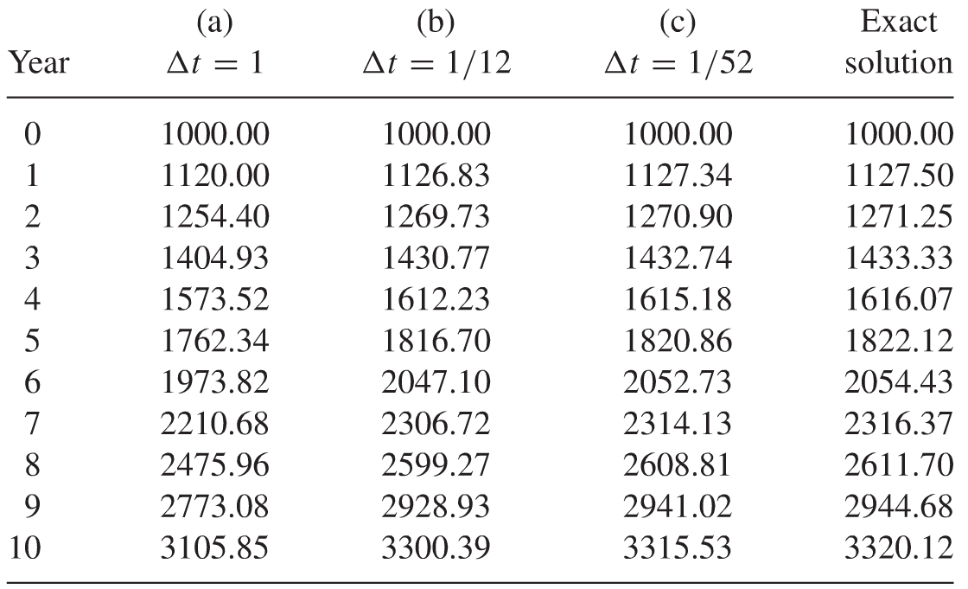
Numerical Approximation Methods
A Savings Certificate Revisited

Slide 29
11.6 Separation Of Variables
Already reviewed throughout the course:
Examples
Equations of Motion
Population Growth
Logistic Growth
Newton’s Law of Cooling

Slide 30
11.7 Linear Equations
Review: First-Order Linear Equations
Show that the first order equation in standard form
Can be solved by using the integrating factor
To obtain

